Slide 1
Incorporating CSSR with HCTSA
Haohua Li

Slide 2
HCTSA and CSSR

Slide 3
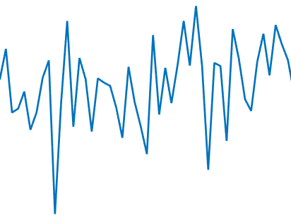
HCTSA at the first glance
The full name of HCTSA is highly comparative time-series analysis.
Given a time series/epochs and a bunch of algorithms for time-series analysis in literature, HCTSA will return some numbers as output as summary the information hidden in this time series.
Each algorithm/function is also run with different sets of input parameters.
HCTSA can also compare outputs across different time-series.
A time series
Mater operations
Outputs/Operations
EN_PermEn(y,2,1)
EN_PermEn(y,3,1)
EN_PermEn(y,4,1)
EN_PermEn(y,5,1)
….
EN_MS_LZcomplexity(y,2,[])
EN_MS_LZcomplexity(y,3,[])
EN_MS_LZcomplexity(y,4,[])
EN_MS_LZcomplexity(y,5,[])
...
0.0153
0.0586
0.0734
0.0872
…
2.3154
2.1215
2.3484
2.1545
....
HCTSA

Slide 4
Why HCTSA
HCTSA has a collection of around 1000 promising operations for time-series analysis.
Once a set of results have been computed, HCTSA can be easily used to perform a wide variety of highly comparative analyses, including classification and clustering. (Fulcher, 2017)
HCTSA can be used to assess the performance of a newly developed algorithm (e.g. CSSR in this case) across a range of interdisciplinary time-series data. HCTSA will execute algorithm on a diverse of time series sampled from across science. (Fulcher, 2017)
Example: Determining the relationship between a new feature and existing features (Fulcher, 2017).

Slide 5
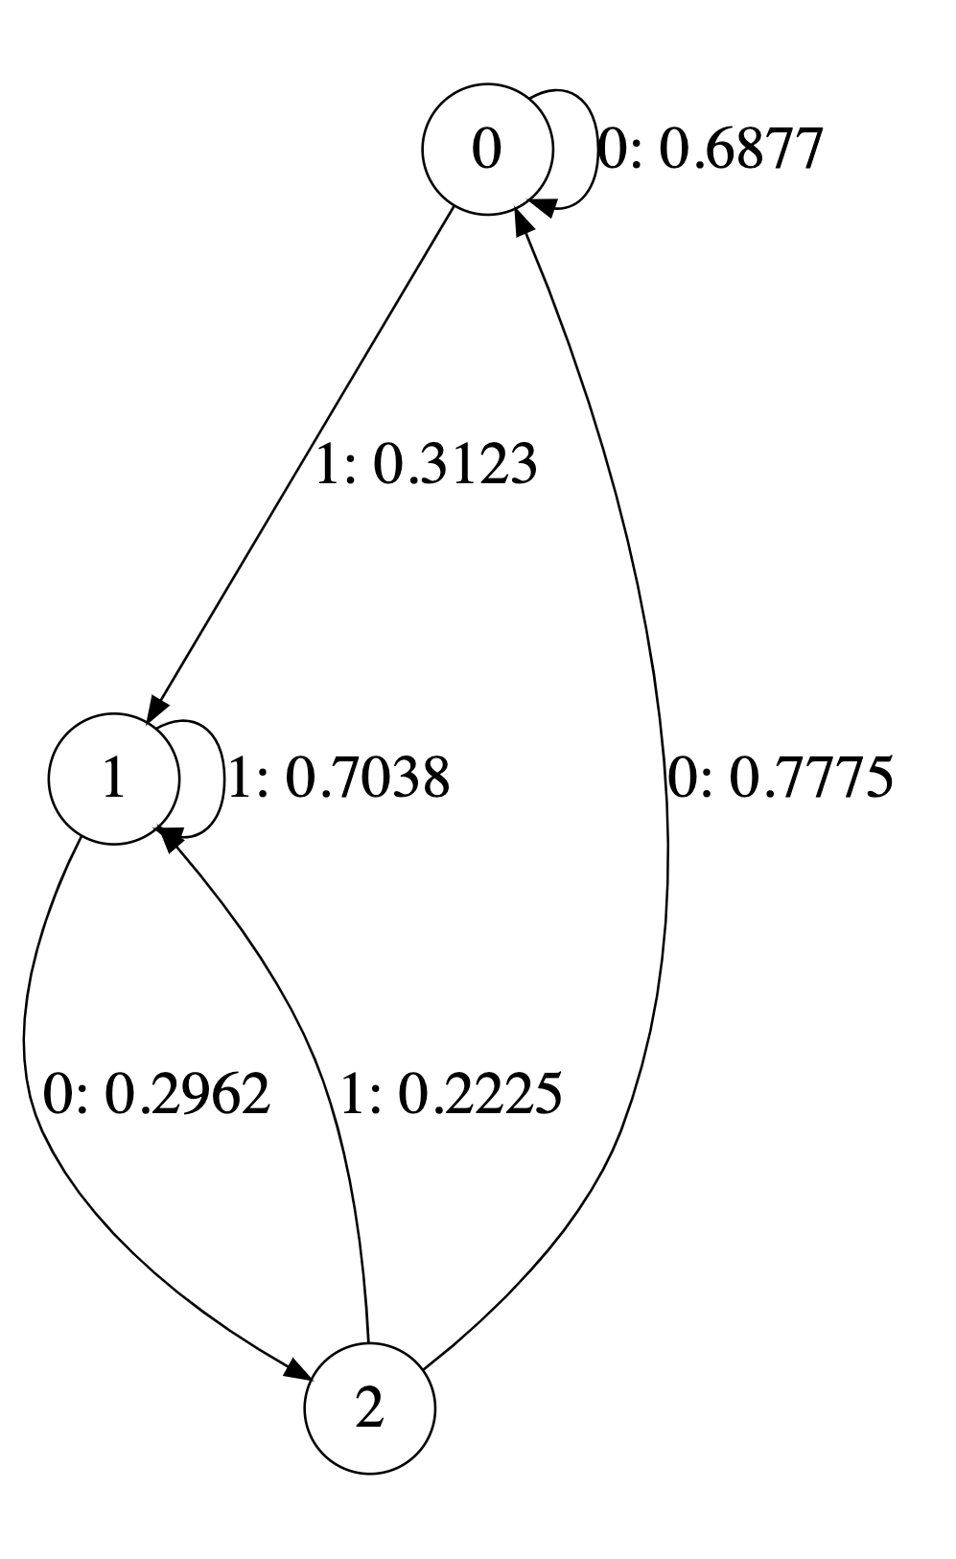
CSSR and Epsilon Machine
Given a sequence, the CSSR algorithm will group those sub-sequences which emit the same symbol together into a causal state.
The generated state series can use to measure the statistical complexity of the given sequence, which implies the how complicated a stationary stochastic process is.
0 1 1 1 0 1 0 1 …
0 1 1
1 1 0
0 1 0
1 1 1
1 0 1
0 1 1 1 0 1 0 1 …
...
Causal State 1
Causal State 2
State series
0 1 1 1 0 1 0 1 …
1, 2, 1, 2, 1, …

Slide 6
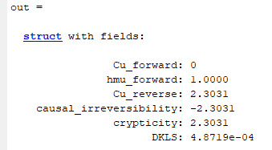

CSSR in Matlab
If CSSR can run internally in Matlab, then CSSR can be easily integrated into HCTSA framework. Although CSSR is a native C++ program, Matlab provides a wrapper called MEX-function which link C++ compiler to Matlab.
MEX
CSSR.cpp
CSSR.mexw64
* y is a Gaussian normal distribution, with median split, 50% of samples are recognised as 0, the other as 1.
(kriangkhajorn, 2018)

Slide 7
Epsilon Machine Analysis

Slide 8
Overview
Epsilon Machine
State space (definition of characters in epsilon machine)
Temporal asymmetry analysis
Preliminary Analysis on Human EEG data
Future Direction

Slide 9
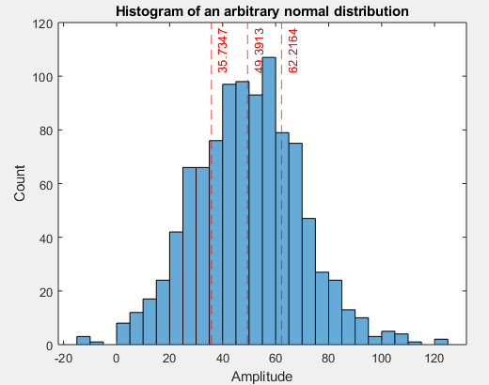
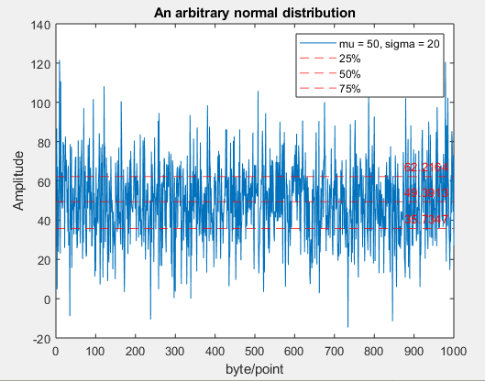
State Space (1) - Simple Transformation
A common issue in analysing bio-signal (e.g. electroencephalography EEG) is how to encode the raw time series.
Encoding here means converting the time series of real number data into a sequence of symbols (Kim, et.al 2018).
Binarisation (e.g. 0 and 1)
Median split
Difference split
Multiple Levels (e.g. ABCD)
Top/multi-level split
Distribution of the data vector/ Histogram :
<25% 25~50% 50~75% >75%
[ .... …. …. …. ]
* When number of level is 2, top split is basically median split.

Slide 10
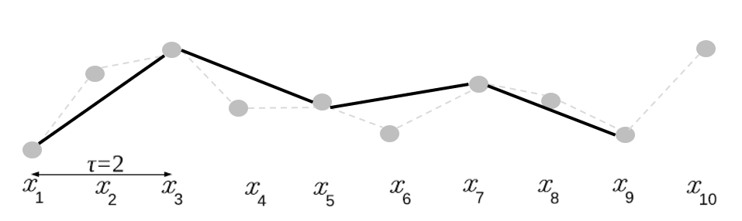
State Space (2) - Symbolic Transformation
Symbolic Transformation (King. et.al 2013)
Capture and summarise dynamical pattern of a time series (see figure below).
Robust to noises and linear trend.
Order of ordinal pattern
Number of permutations is (order+1)!
Delay between samples
Delay is the distance between points in ordinal patterns.
However, aliasing may occur.
Notes:
wSMI (weighted symbolic mutual information)
This paper used a concept of Bandt & Pompe’s Permutation entropy (PE).
Haohua’s note on symbolic transformation
If my understanding is incorrect, feel free to correct it.
If delay is greater than 1 (tau = 2 in the figure), although in-between points are ignored, but ordinal pattern can still capture the trend.
This is very similar to how people analyse stock prices. Ordinal pattern sequence will more care about the general trend instead of transient variation.

Slide 11

State Space (2) - Symbolic Transformation
In permutation entropy, an ordinal pattern is obtained by shifting the window by #order. (King et.al 2013)
x(1) = d
dbe
x(2) = b
x(3) = f

Slide 12
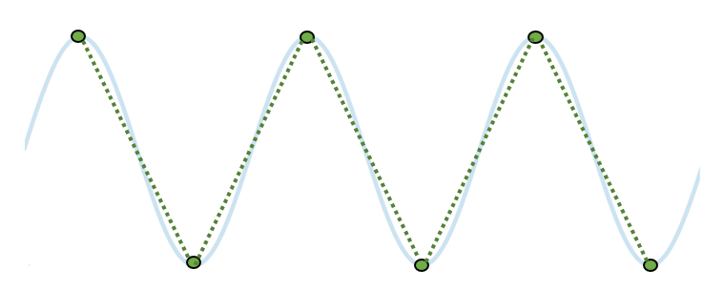
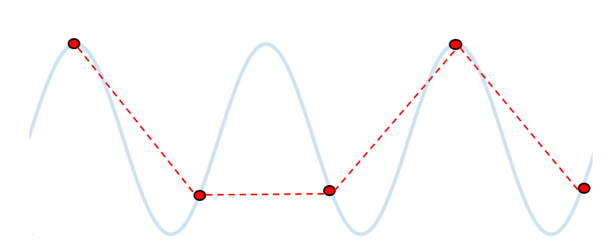
Symbolic Transformation - Potential Aliasing
What is the extreme value of delay (without information) ?
Ordinal pattern sequence basically samples a continuous time-series.
Hence, the delay of a ordinal pattern sequence is subject to Nyquist sampling theorem.
If delay is greater than one, some components in the high-frequency domain may be missed.
Aliasing may occur if Nyquist sampling theorem is not satisfied.
Due to aliasing, identification of ordinal pattern may be wrong (see figure below)
A proper ordinal pattern sequence
With aliasing artifacts

Slide 13





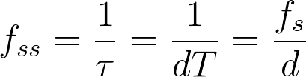
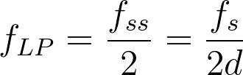


Symbolic Transformation - Potential Aliasing
Sampling rate fs of the input time series and sampling interval T
Aliasing (King et.al 2013)
Assume the highest frequency in the input time series is
The sampling frequency of symbolic transformation is
Time-lag is
Delay in samples is defined as
Nyquist sampling theorem requires
Hence,
To ensure meet Nyquist theorem, a low-pass filter may be used. (remove components higher than which result in aliasing artifacts). The cut-off frequency is

Slide 14
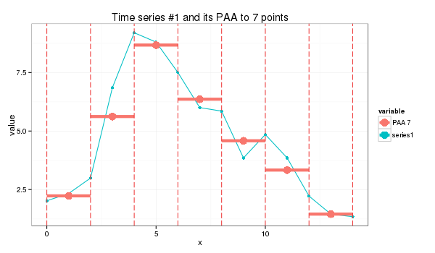
State Space (3) - Piecewise Aggregate Approximation
PAA https://jmotif.github.io/sax-vsm_site/morea/algorithm/PAA.html
Use a mean value to represent a segment.

Slide 15
State Space (4) - Symbolic Aggregate Approximation

Slide 16


Temporal asymmetry measurement
Some quantifiers of temporal asymmetry (Muñoz et.al, 2020)
Causal irreversibility
Crypticity
Rate of KL divergence
* Where Cmu+ represents the statistical complexity of forward epsilon machine, Cmu- is the statistical complexity of reverse epsilon machine. Cmu+- is for bi-directional epsilon machine.
** M+ and M- is the normal distribution of forward and reverse epsilon machines, respectively.
*** D_KLS is the the asymptotic rate of (symmetric) Kullback-Leibler (KL) divergence between long output sequences of epsilon machines.

Slide 17

Bi-directional Epsilon Machine
Given the forward state series and the reverse state series, we can construct a bi-directional epsilon machine. In this case, both the forward and reverse epsilon machine contribute the bi-directional epsilon machine.
The causal states of bi-directional machine is the cartesian product of forward and reverse causal states, which is defined as
S+ is the set of causal states of forward machine, S- is the set of causal states of reverse machine.
Why bi-directional epsilon machine? In some special cases, although statistical complexities of two epsilon machine may be same, but the transition matrices may totally different.
Forward State series
Bi-directional State series
1, 4, 2, 5, 1, …
(1,3), (4,9), (2,7), (5,2), (1,8), …
Reverse State series
Flip
…,8, 2, 7, 9, 3
3, 9, 7, 2, 8, ....

Slide 18

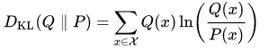
KL divergence on Epsilon Machine
KL divergence can be used to compare between probability distributions.
The epsilon machine has a probability distribution of emitting all possible sequences of symbols with length L (L is recommended to be greater than the maximum history length of epsilon machine).
Three challenges
KL divergence assumes non-zero probabilities in the distribution.
If L = 8, |A| = 4, there will be 65536 sequences to compute.
If using matrix store transition probabilities, Matlab will complain out of memory.
(Wikipedia contributors, 2020)

Slide 19
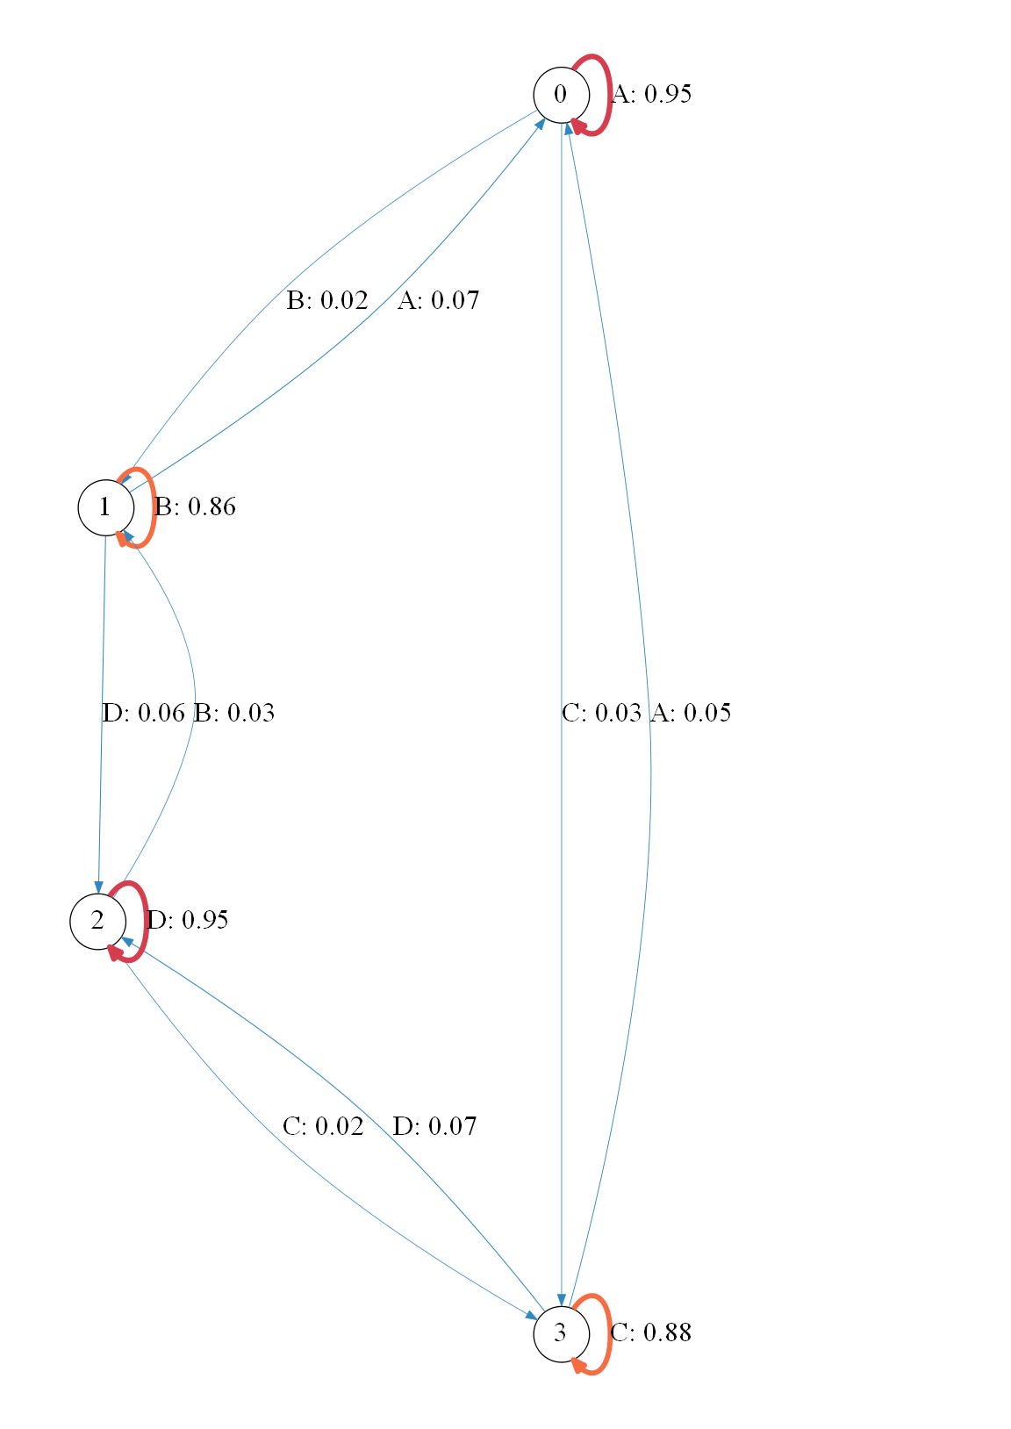
KL divergence on Epsilon Machine
L = 4, |A| = 4,
All possible sequences.
A A A A
A A A B
A A B A
…
D D D D
P(AAAA) =
P(S0) x P(S0 -> S0)^4
+ P(S1) x P(S1 -> S0) x P (S0 -> S0)^3 + P(S2) x 0
+ P(S3) x P(S3 -> S0) x P(S0 -> S0)^3

Slide 20
KL divergence on Epsilon Machine
Hence, the rate of KL divergence between two machines M1 and M2 can be computed (see https://github.com/aidan-zec/brain_machine).

Slide 21
Preliminary human EEG analysis
Differentiate between wake and anesthesia

Slide 22




Hypotheses
H1 : the statistical complexity of Epsilon machine indexs of the level of consciousness.
H2 : Temporal asymmetry should be higher for awake brain - irreversibility, crypticity, rate of KL divergence.

Slide 23
Stationarity Assumption
CSSR assumes the input stream satisfies stationarity.

Slide 24
Experiment Pattern
General question: how to measure the level of consciousness during unresponsiveness/anaesthesia.
Experiment procedures (Colombo et.al, 2019 NeuroImage)
N=15 healthy participants were divided into three groups
Each group would undergo different anaesthesia conditions induced by either xenon, propofol or ketamine.
Wakefulness data: before anaesthesia, each participant’s EEG were recorded.
Anaesthesia data: following drug administration, each participant progressively lost their responsiveness. EEG were recorded upon their deep unresponsiveness.
After the experiment, participants who recovered from the anaesthesia were asked to report their conscious experience. Responses were split into two categories: 1) no report; 2) conscious report.
Be allowed to assess consciousness beyond responsiveness.
Participants who can recall their conscious experience were to be considered as maintaining their consciousness during anaesthesia.

Slide 25
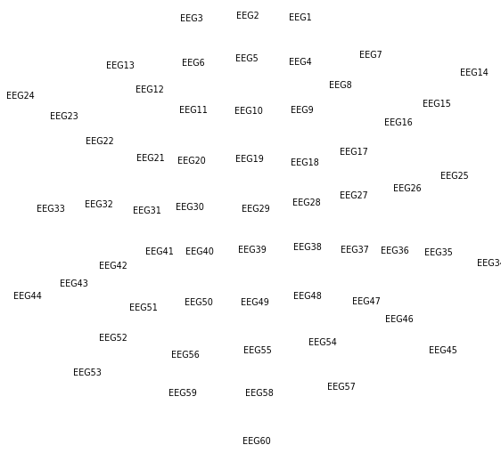
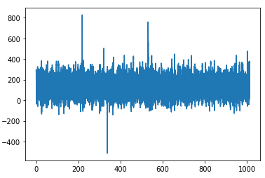
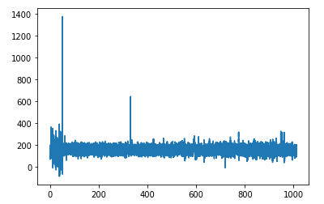
Channel Selection
EEG layout (by MNE)
Subject H0048
Channel 29 without re-referencing, the waveform indicates it is a good channel (stationarity holds in general).
Anesthesia induced by propofol
Awake state

Slide 26
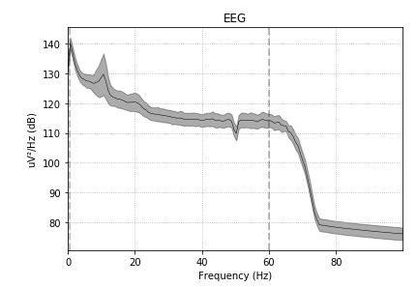
Preprocessing
Bandpass filter
From 0.5 to 60 Hz
Remove line noise and harmonics.
Difference binarisation

Slide 27
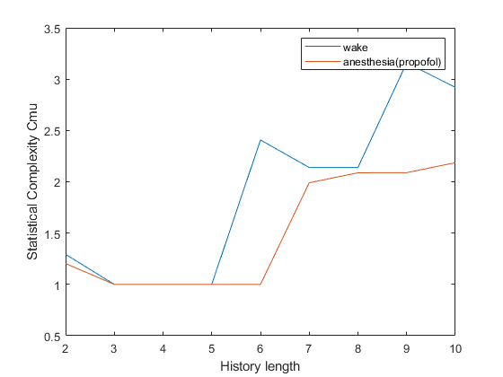
Results Cmu
Subject H0048
propofol
Statistical Complexity

Slide 28
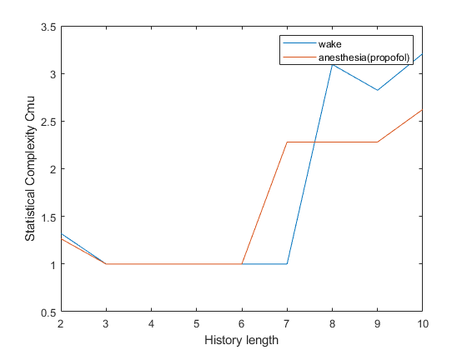
Results Cmu
Subject H0905
xenon
Statistical Complexity

Slide 29
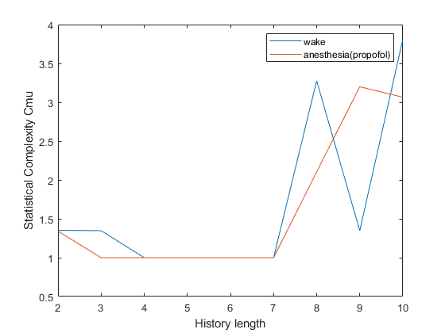
Results Cmu
Subject H0534
ketamine
Statistical Complexity

Slide 30
Future Plan
Verify the implementation of temporal asymmetry measuring algorithm (KL divergence).
Apply CSD as preprocessing
Consider what parameters (e.g. history length, definition of state space) should be included in HCTSA.

Slide 31
Reference
….

